Slide 1
Improving stroke services - lessons from the latest NIHR research
@NIHRevidence
#NIHRStroke

Slide 2

Using machine learning to identify how to increase the disability benefit from intravenous thrombolysis
Prof Martin James
Peninsula Applied Research Collaboration
on behalf of
Mike Allen, Charlotte James, Julie Frost, Kristin Liabo, Kerry Pearn,
Tom Monks, Richard Everson, Ken Stein

Slide 3
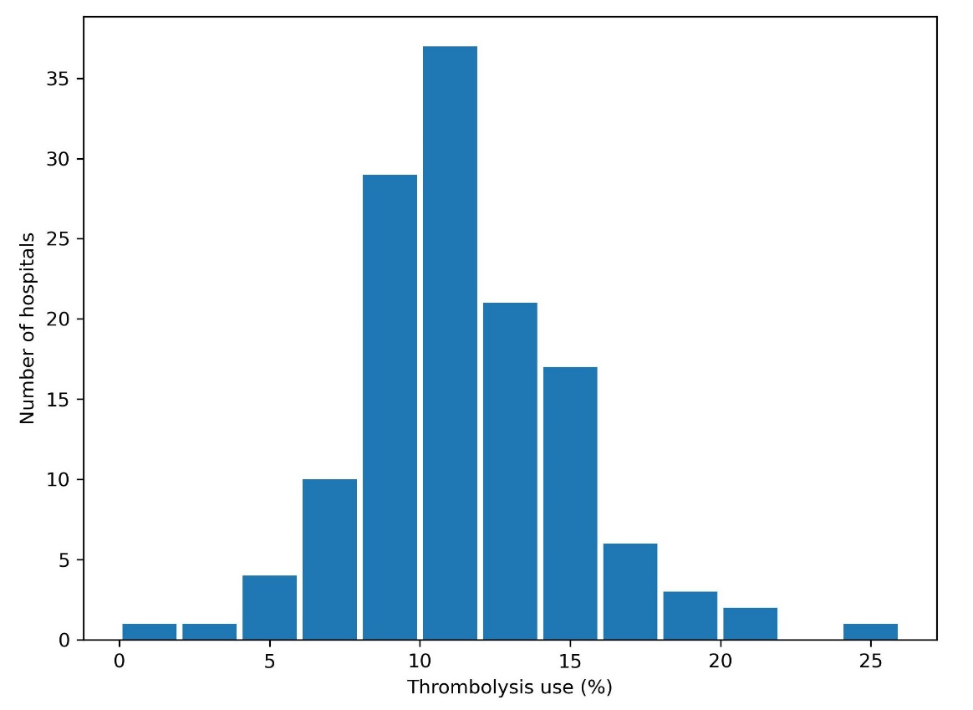
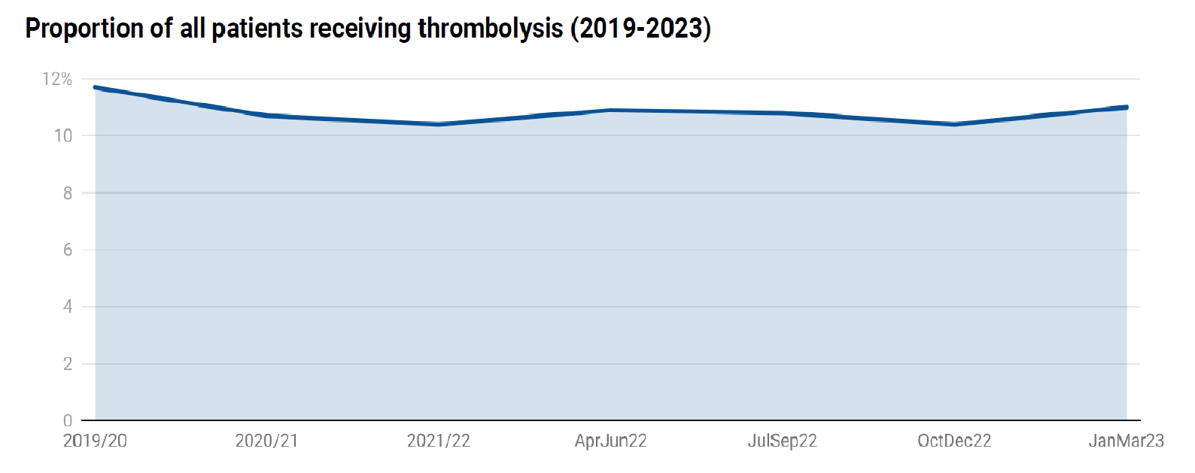
National thrombolysis rate 2019-23
Is there any room for improvement?

Slide 4
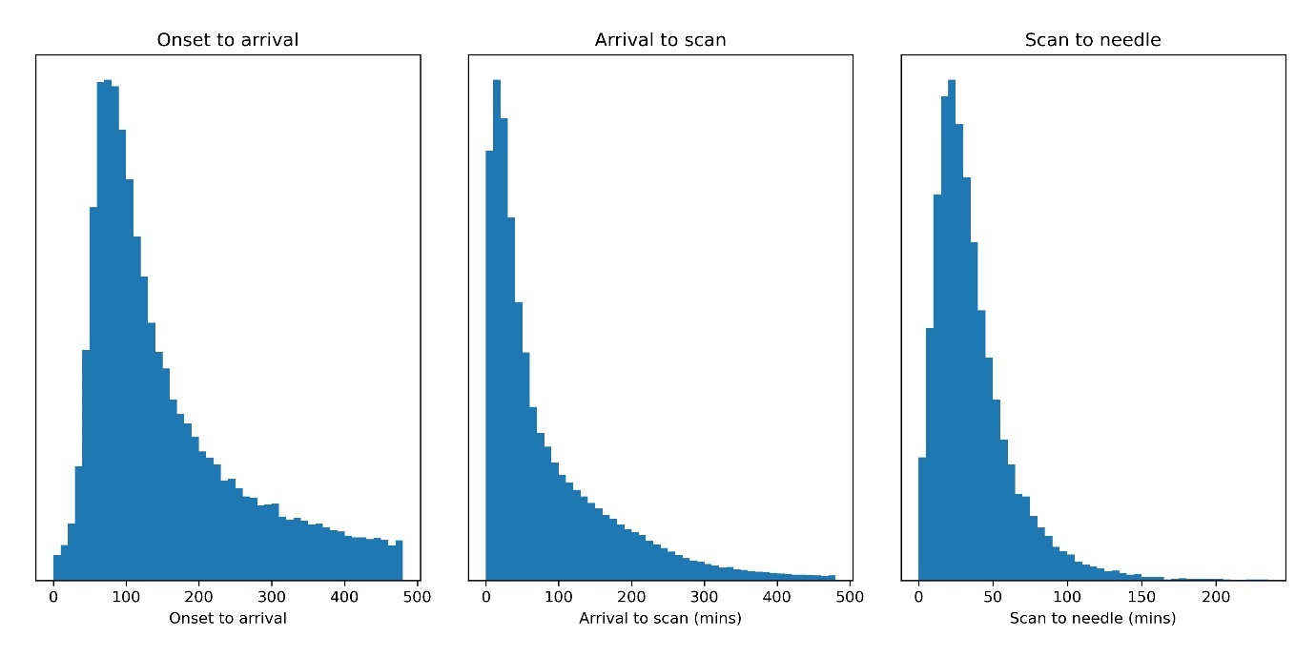
SAMueL: Big Data and Machine Learning
Hospitals had similar door-to-needle times –
but we can still improve
Are there other ways to increase thrombolysis?

Slide 5


SAMueL: Big Data and Machine Learning
Three years of national audit data (>240K admissions) with over 26,000 thrombolysed cases
Inputs:
Age
Sex
Comorbidities:
Congestive HF
Hypertension
Atrial Fib
Diabetes
Antithrombotic treatment
Pre-stroke disability (mRS)
Stroke Type
Stroke severity
Stroke characteristics
Level of consciousness
Eye movement
Visual field
Motor arm/leg
Limb ataxia
Sensory
Language
Dysarthia
Extinction/Inattention
Time of onset/arrival/scan
Thrombolyse?
Method is 85% accurate for confirmed stroke patients arriving within
4 hours of stroke onset
Less than half (42%) of variation in thrombolysis rates is accounted for by patient characteristics

Slide 6
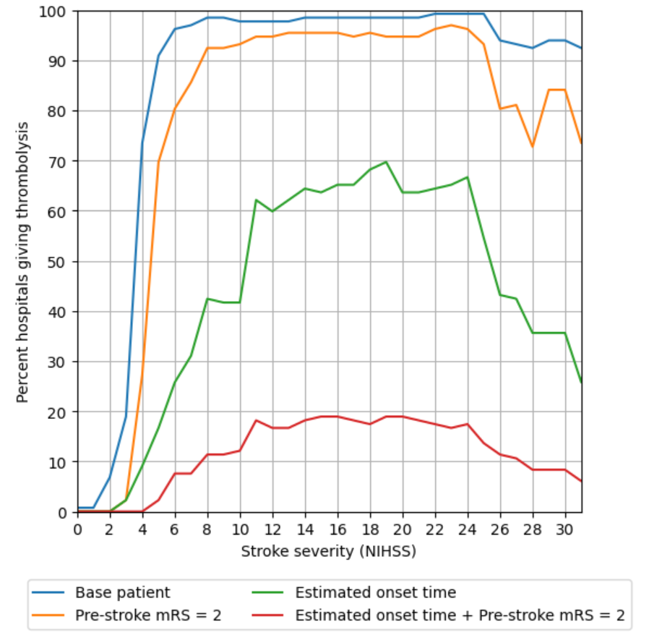
‘Willingness to thrombolyse’ by various factors

Slide 7
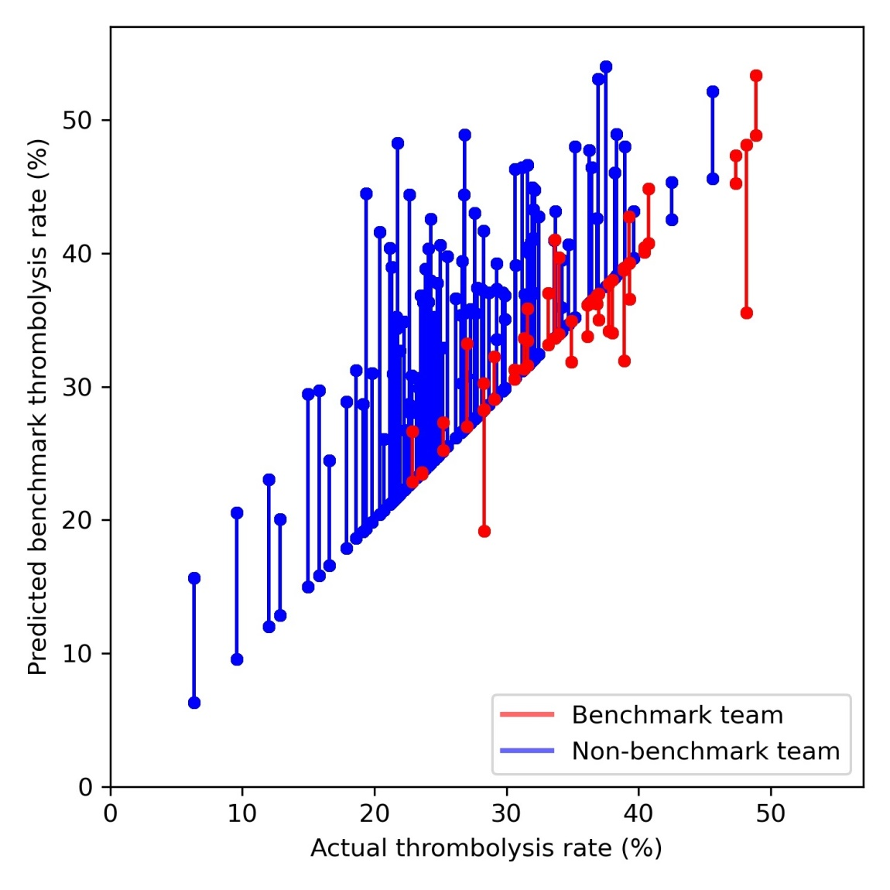
SAMueL: Big Data and Machine Learning
Helping all centres
to learn from
the top third of centres
‘The machine’ learns from the thrombolysis decisions of the ‘benchmark’ top-30 hospitals
Overall thrombolysis rate could increase from 10.5% to 16.4% by adopting the habits of high-performing centres
We should reasonably expect to thrombolyse at least one-third of patients who arrive within 4 hours

Slide 8
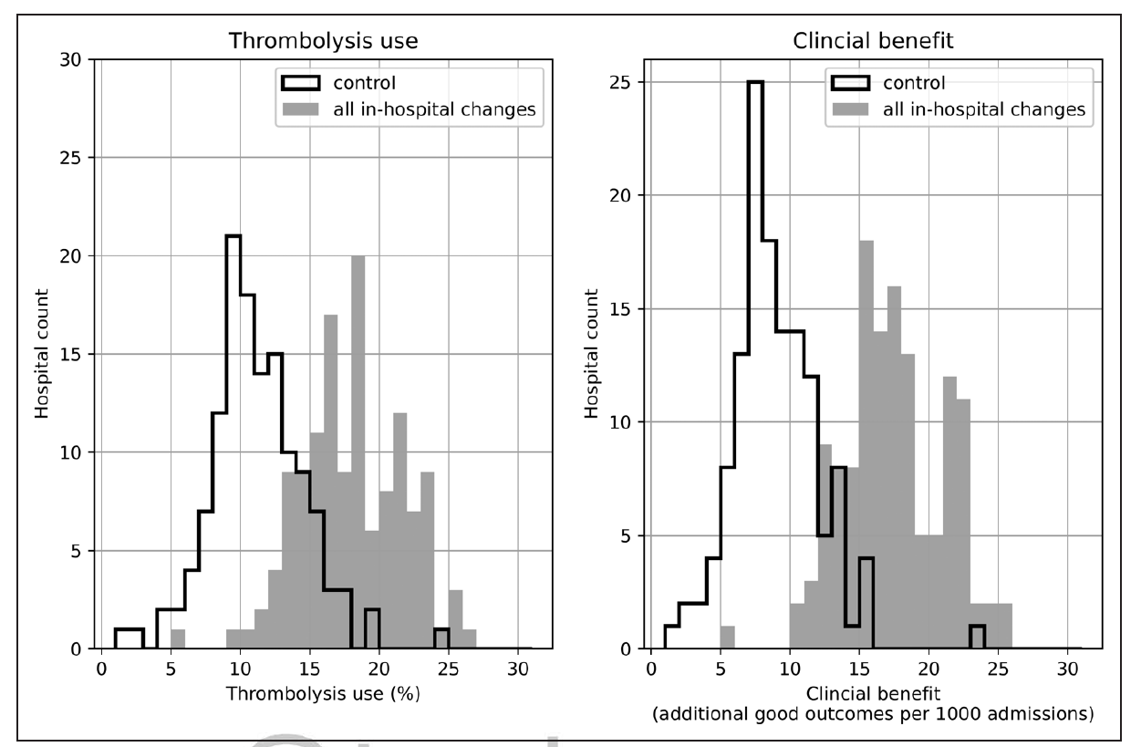
SAMueL: Additive benefits from pathway improvements
+58%
+88%

Slide 9
What can machine learning teach us about thrombolysis?
What is the issue?
Persistent severe unwarranted variation in thrombolysis rates, clinical practice and population benefit 20 years after first use in the UK for acute stroke
What’s new?
Machine learning from big data showed how to reduce variation in thrombolysis rates and substantially decrease the number of people with disability after a stroke.
More people would benefit from thrombolysis if hospitals address:
door-to-needle time
known onset time
willingness to thrombolyse.

Slide 10
What can machine learning teach us about thrombolysis?
Why is this important?
Current variation in thrombolysis use is unacceptable. Action to address these 3 factors would deliver the greatest benefit to the greatest number of people with stroke.

Slide 11
Myth-busting about thrombolysis
Patients are FAR more similar than they are different – the ‘special hospital’ fallacy is an all-too-convenient myth
We are not at the ceiling of benefit from thrombolysis. A national average thrombolysis rate of 18% is achievable and could nearly double the population benefit
It’s not just about speed. Simple steps like establishing the onset time in >75% of patients can provide significant benefit to patients
Learning from the habits of top-third sites can provide significant benefit to patients
Realistic, achievable ambitions for IVT can be derived for individual sites – that’s what we are doing in SAMueL-2

Slide 12
Large-scale implementation of stroke early supported discharge: the WISE realist mixed-methods study
Dr Niki Chouliara
University of Nottingham

Slide 13



Background
1. Are ESD services effective when implemented at scale in practice?
2. What influences how effective services are in delivering ESD?
Hospital
Home
Acute
Rehab
ESD
Rehab
Support

Slide 14
Methodology
Hypotheses to be tested:
1. Core ESD important for achieving a responsive and intensive intervention.
2. Core components of ESD will operate differently in urban and rural settings.
3. Communication processes across the pathway important for implementing a evidence-based service.
Contextual Influences
Service capacity
Geographical location
Referring services characteristics & locations
Communication processes across stroke care pathway
Core ESD components
Team composition
Staff/patient ratio
Multidisciplinary team coordination (e.g. meetings)
Stroke specialist & staff training
Weekly service of >5 days
Outcomes
Responsiveness- Days to ESD*
Rehabilitation intensity
* Responsiveness: days from hospital discharge to first contact
Intensity: total number of treatment days/total days with ESD

Slide 15
Data
Historical data from the National Audit Programme (SSNAP) in December 2016, from 31 ESD teams in England.
A 17-item ESD consensus score to quantitatively measure the
adoption of core components and assess whether they relate to intensity
and responsiveness.
Interviews with 117 clinicians and 30 patients from six ESD sites in England.
Documentary evidence of the service model and associated costs.

Slide 16
Results: Responsiveness (Days from hospital discharge to first contact)
Defined core components
Selection criteria on disability levels
Flexible approach to who makes the first contact
Highly valued by stroke survivors.
Notes:
controlling for patient characteristics and ssnap hospital score
Adopting defined core components was associated with a more responsive service (SSNAP)
Adhering to selection criteria on disability levels was key to timely admissions and helped manage capacity issues (staff interviews)
Having a flexible approach to who makes first contact with patients; the role of rehabilitation assistants (staff interviews)
Responsiveness was highly valued by stroke survivors (patient interviews)

Slide 17
Results: Intensity (No of treatment days/total days with ESD)
Defined core components
MDT working and an interdisciplinary skillset
Responding to gaps and addressing unmet patient needs
Most received as much therapy as they could cope with.
Notes:
Adopting defined core components was associated with higher rehab intensity (SSNAP data)
MDT working (SSNAP data) and developing an interdisciplinary skill set (staff interviews) helped temas provide intensive input in an efficient way
Respondied to gaps in the care pathways and addressing unmet patient needs diluted the intensity of hands-on therapy (staff interviews)
Most patients felt the received as much therapy as the could cope with, time- and energy-wise (patient interviews)

Slide 18
Results: Rurality
No significant relationship between rurality and intensity/responsiveness
The effects of adopting core components were similar for rural and urban sites
Travel time was a challenge in rural/large areas
Adaptations to MDT structures and processes.
Notes:
No significant relationship between level of rurality and intensity /responsiveness (SSNAP)
The effects of adopting core components were similar for rural and urban sites (SSNAP)
The time required to travel to patients was a challenge for services covereing rural large geographical areas (staff interviews)
Teams adapted MDT structures and processes eg dividing MDTs into sub-teams covering different geographical areas (staff interviews)

Slide 19
Results: Communication processes
Communications quality impacts on responsiveness and intensity targets
Embedded social worker
Collaborative links with referring stroke units
Stoke survivors called for improved communication and information.
Notes:
The quality of communications across services impacts on ESD services ability to achieve responsiveness and intensity targets (staff interviews)
Having a social worker embedded in the pathway associated with a more responsive service (SSNAP/staff interviews)
Importance of sustaining collaborative links with referring stroke units through formal and informal communication processes eg cross-boundary working arrangements (staff interviews)
Stroke survivors called for improved communication and information provision (patient interviews).

Slide 20
Implications for health care and policy
Adopt core evidence-based components
Protect MDT meetings; invest in interdisciplinary skills
Additional resources for rural services
Role of ESD in comprehensive, needs-based care.
Notes:
Findings support the need for adoption of core evidence-based components in achieving a responsive and intensive ESD service. These included the delivery of the service to eligible patients, by well-staffed and coordinated MDTs.
ESD services should protect MDT meeting and invest in developing an interdisciplinary skillset
Additional resources may be required for rural services to meet evidence-based criteria
ESD teams have an important role to play beyond the delivery of therapy and towards efforts to provide comprehensive, needs-based care

Slide 21

Impact
Findings informed:
New integrated model of stroke rehab provision (ICSS; NHS England, 2022)
National Clinical Guideline for Stroke for the United Kingdom and Ireland (2023)
Hospital
Community
All stroke survivors, regardless of disability, should be able to access specialist community-based rehabilitation
Stroke care pathway
Notes:
What about stroke survivors with complex needs who require support for longer?

Slide 22
The issue:
Is Early Supported Discharge in stroke effective when implemented in practice?
What’s new?
The ESD model of operation varies across England in response to local context. The adoption of core components of ESD (e.g. specialist rehabilitation by well-staffed, co-ordinated MDTs) helped deliver services that met evidence-based standards.
Findings call for a more integrated and comprehensive service provision, addressing the needs of stroke survivors with severe disabilities.
Why is it important?
This study distinguished between characteristics of the intervention that need to be safeguarded, and elements that can be adapted (e.g. how MDTs are organised to cover rural areas).
Lessons learned could help teams customise interventions and deliver evidence-based services in local contexts.
Findings have informed the development of the Integrated Community Stroke Service model.
Notes:
Note to speaker - in summing up, please give examples of core components and of elements that can be adapted.

Slide 23

Acknowledgements
The research team:
Dr Rebecca Fisher, Principal Investigator
Dr Adrian Byrne, Research Fellow, Statistical analyses
Dr Trudi Cameron, Research Fellow, Qualitative analyses
The WISE project co-applicants:
Prof Marion Walker, Prof Tom Robinson, Prof Peter Langhorne, Prof Justin Waring,
Prof Sarah Lewis, Prof Claudia Geue, Prof Tony Rudd.

Slide 24
REhabilitation and recovery of peopLE with Aphasia after StrokE (RELEASE)
Dr Myzoon Ali
On behalf of the RELEASE Collaborators

Slide 25
Disclosures
This project was funded by the National Institute for Health Research (NIHR), Health Services and Delivery Research Programme (HS&DR–14/04/22) and the Tavistock Trust for Aphasia.
NMAHPR RU is funded by the Chief Scientist Office (CSO), Scottish Government Health and Social Care Directorates.
The project originated amongst members of the Collaboration of Aphasia Trialists (IS1208) funded by the EU Cooperation in Science and Technology (COST IS1208 2013-2017) and the Tavistock Trust for Aphasia (TTA) (2017-2020).
The views expressed here are those of the authors and not necessarily those of the National Health Service, the NIHR, the CSO, COST, the TTA or the Department of Health and Social Care.
There are no conflicts of interest to declare.

Slide 26
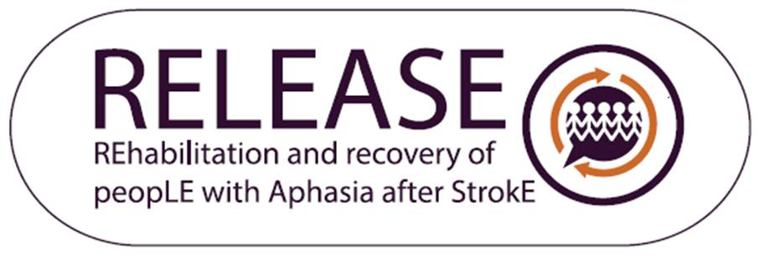
Research Questions
What is the pattern of language recovery following stroke-related aphasia?
What are the predictors of language recovery outcomes following aphasia
What are the components of effective aphasia rehabilitation interventions
Are some interventions (or intervention components) more beneficial for some patient subgroups (individual, stroke or aphasia characteristics) than others?

Slide 28

Predictors of Recovery
Greatest Recovery
Functional Communication
Overall Language Ability
Auditory Comprehension
Within 1 month of onset
Greater absolute change in overall language ability, auditory comprehension, naming and functional communication
<55 years
female sex (certain modalities)
enrollment within 1 month

Slide 29
Therapy Regime
Associations - greatest gains and therapy
Language outcome | Frequency days weekly | Dosage total SLT hours | Intensity hours weekly
Overall language | 4-to-5 days | 20-to-50 hours | 2-to-4 hours
Functional Communication | 4-to-5 days | 20-to-50 hours | 2-to-4 hours
Auditory comprehension | 4-to-5 days | 20-to-50 hours | 9+ hours
Notes:
home practice was associated with greater gains and that therapy programmes designed by SLTs but delivered by family/volunteers showed no indication of a difference in language recovery from therapy programmes delivered by SLTs themselves

Slide 30
Precision: Age
Older
>9 hours auditory comprehension
≤2 hours/week
Working Age
3-4 hours functional communication
>9 hours auditory comprehension
>9 hours weekly overall language
Notes:
Where there were differences
Greatest language gains from baseline for working-aged participants occurred alongside moderate- to high-intensity SLT (>9 hours/week overall-language and auditory comprehension; 3-to-4 hours/week functional communication); older participants’ greatest gains occurred alongside low-intensity SLT (≤2 hours/week) except for comprehension (>9 hours/week).

Slide 31
Precision: Time post-stroke
≤3 months
20-to-50 hours
≤2 SLT-hours/week
>3months
≥50 hours
3-4 SLT-hours/week
Notes:
Greatest overall-language gains for participants ≤3 months post-onset were associated with low-intensity/moderate-dosage (≤2 SLT-hours/week; 20-to-50 hours); for those >3 months post-stroke greatest gains were associated with moderate-intensity/high-dosage SLT (3-4 SLT-hours/week; ≥50 hours).

Slide 32
Precision: Aphasia Severity
Moderate -Severe
4 SLT-days/week
Mild-moderate
⩾ 4 SLT-days/week functional communication
≥6 days/weekly for overall language
Notes:
For moderate-severe participants, 4 SLT-days/week conferred the greatest language gains across outcomes; mild-moderate participants’ greatest overall language gains were associated with higher frequency SLT (≥6 days/weekly). Consistencies across groups were also evident.
For moderate-severe participants, auditory comprehension gains only observed for ⩾ 4 SLT-days/week; mild-moderate participants' greatest functional communication gains were associated with similar frequency (⩾ 4 SLT-days/week) and greatest overall-language gains with higher frequency SLT (⩾ 6 days/weekly).

Slide 33
Summary
The issue
  Aphasia recovery not fully elucidated
  We need information on the components of effective SLT rehabilitation
What’s new?
  Certain language domains recover more than others
  Greatest gains associated with higher dose SLT than reported in current practice
  Therapy started within 28 days conferred greater gains than therapy started later
Why is this important?
For research …
Targeted RCTs to address the evidence gaps
Definitive RCTs to examine an SLT/language dose-response relationship.

Slide 34
The RELEASE Collaborators
myzoon.ali@gcu.ac.uk
@myzoonali
@marianbrady
@Cats_aphasia

Slide 35
Thank you for listening
Please post any questions in the Q&A box
@NIHRevidence
#NIHRStroke

